Slide 1
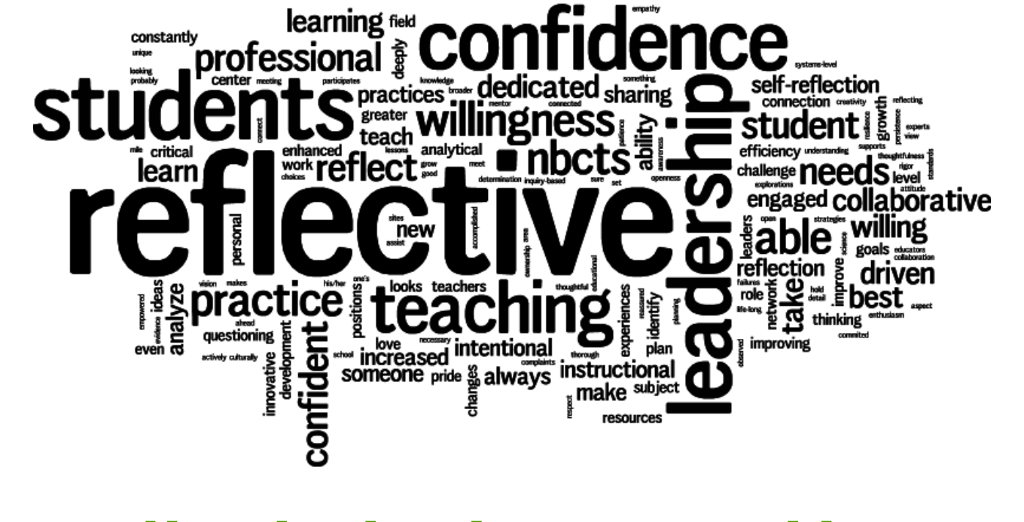
The National Board Certification Process and Woodland Public Schools

Slide 2
What is National Board Certification?
Pathway for accomplished teachers to demonstrate their skills beyond basic licensure requirements
Focused around the Five Core Propositions
Certificates are subject/grade area specific & standards based
4 Components
Max of 5 years
Renewal process

Slide 3
Research Supporting Efficacy of NBCTs
Harvard University’s Strategic Data Project reported that students of Board-certified teachers in the Los Angeles Unified School District gained roughly the equivalent of two months of additional instruction in Math and one month in English Language Arts. Among math teachers, this contrasts with a lack of a significant impact by teachers who held only advanced degrees (Strategic Data Project, 2012). In a similar study in Gwinnett County, Georgia, Board-certified teachers outperformed their peers with the same levels of experience (Strategic Data Project, 2012a).
In Washington state, a multiyear study found that “[Board-] certified teachers are more effective than non-certified teachers with similar experience.” Their findings suggest Board-certified teachers produce gains of up to 1.5 months of additional learning. (Goldhaber and Cowen, 2015).
Find more research and information: http://www.nbpts.org/advancing-education-research

Slide 4
Benefits
For Students
Process helps teachers individualize instruction
NBCTs focus on learning and growth for every student
Research suggests students learn more from NBCTs
For Teachers
Asks teachers to deeply analyze, defend and improve their practice
Value comes from the process, not just the result
Leadership opportunities within the school

Slide 5
National Board and WA State
OSPI Partnership
Conditional Loans
Cohorts
Regional Coordinators
Candidate Support Events
WEA Support Programs
Legislative Support

Slide 6
Woodland and NB Support
Current Supports in Place
Cohort
Financial support
Administrative support
Woodland Cohort Program boasts the one of the highest success rates.

Slide 7
Recognition of Staff
Please congratulate this year’s candidates who hold the highest standard of certification in the nation.
Katie Klaus (New)
Rebecca Blanshan (Renewed)
Michael Lindsay (Renewed)
Kelly Beasley (Renewed)

Slide 8
Currently 20 Woodland teachers hold this elite certification
BEASLEY, KELLY (WMS) | KEEFER, KYLA (WHS)
BLANSHAN, REBECCA (WMS) | KLAUS, KATIE (WHS)
BULLOCK, MIRANDA (WHS) | LINDSAY, MICHAEL (WHS)
CHURCHMAN, JAMIE (NFES) | LONG, CYNTHIA (NFES)
CONDITT, SHARON (WHS) | SMITH, JILL (WMS)
COWLEY, JASON (WHS) | TALVITIE, ELIZABETH (WHS)
CUTLER, PATTI (NFES) | LINNEMEYER, SHELBY (CES)+
DEGROOT, JANELLE (NFES) | SILCOX, FELICITY (SpEd)+
DOMINGO, JILLIAN (TEAM) | CARLSON-HICKEY, JENNA (NFES)+
EDWARDS, ANDREA (LRA) | CRAWFORD, JOSEPH (WHS)+
+ These Educators have comparable professional certifications for Education Staff Associates (SLP/OT/Psych)

Slide 9
Contact info:
Jason Cowley
cowleyj@woodlandschools.org
Asha Riley rileya@woodlandschools.org

